Slide 1
LUMC Vaccine Metadata Creation & Deployment
Group 2 Xinyue Xie, Yuan Lin, Wei Chen, Yiqin Lei, Yijie Lu

Slide 2
Content
5. Implementation
6. Discussion
7. Conclusion
1. Introduction
2. Team & Expertise
3. Exploring the Problem
4. Plan

Slide 3
Introduction
The goal is to develop a metadata template based on Cedar framework,
Non- Communicable Diseases (NCD) Project in Zimbabwe
Based on the experience of NCD template, we make a proposal for CoHSI2. Transform the data into Cedar, which make it visitable under the principle of FAIR while complying with the privacy regulations at the same time.
Schistosomiasis infection (CoHSI2) performed by LUMC.
In the one-year project, volunteers will be injected with Schistosomiasis, the followed treatment and symptoms are recorded weekly.
Notes:
metadata: creation in human and machine-readable format
vocabulary: a set of commonly agreed terms in a domain, for a clinical research and collaboration related on controlled human
The goal is to develop metadata templates based on rigorous controlled vocabulary and ontology specification, so that the data is visitable under the principle of FAIR while complying with the privacy regulations.

Slide 4
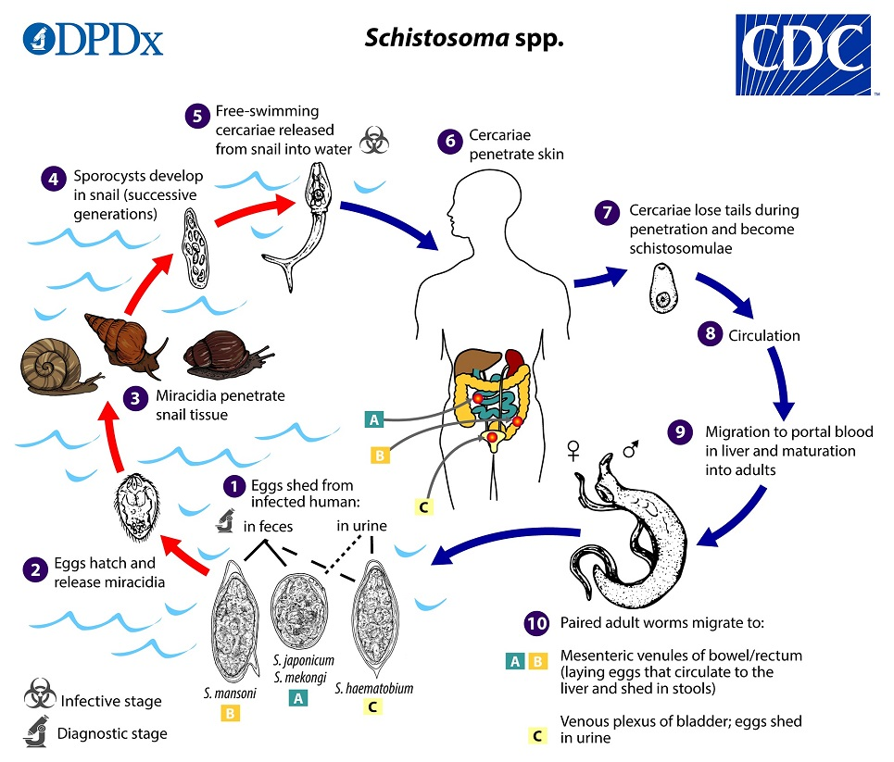
Introduction
Schistosomasis (Schisto.)
a chronic parasitic disease caused by Schistosoma of the schistosome genus.
73 countries in Asia, Africa and Latin America.

Slide 5

Team & Expertise
Xinyue
Automation
Wei
Software Engineering
Yuan
Information
Management
Yijie
Information
Management
Yiqin
Information & Computing Science
Notes:
Despite coming from different disciplines, we are currently all student of Computer Science specialise in Data Science

Slide 6
Exploring the problem (problem statement)
What are the problems that needs to be solved?
For the NCD project, clinical data tend to be collected in a discordant manner.
For the schistosomiasis project in LUMC, most researchers and other people invovled had no previous experience of data sharing.
Why are they a problem?
For NCD project, it has already caused great uncertainty for the efficiency of everyone concerned (e.g., researchers).
The schistosomiasis project in LUMC perhaps puts obstacles in the way of the researchers doing more extensive work and study.
Where is the problem observed?
For the NCD project, this problem is generally observed in the undeveloped regions or countries. For the researchers (for example), it is hard to analyze this kind of data since this takes a long time to integrate.
For the schistosomiasis project in LUMC, the problem holders raise the problem.
Who are affected?
Patient
Clinician
Non-clinician (e.g., medical billers and coders, transcriptionists, hospital executives etc.)
Researchers
…

Slide 7
Exploring the problem (problem statement)
How to solve this problem?
Understand all aspects of the information of data/metadata given by problem holders and stakerholders.
The source of the data/metadata information (template)
When and how is the data collected?
What information or description the data/meta-data have?
Who will fill out these templates? (e.g., clinician or non-clinician ?)
What are the types of each metadata in templates given? (e.g., multi-options, single-option or some metadata consisting of many metadata or sub-elements)
What medical expertise is there to know?
Do we need to sign a confidentiality agreement?
…
Involve extensive colloboration
Implementation of FAIR principles for the NCD project

Slide 8
Exploring the problem (interviews)
Output and feedback (from Aliya)
Introduction (background) of the projects we might be assigned.
The file about NCD metadata template example in Zimbabwe.
The tutorial about how to create the corresponding template in Cedar
The advice on our follow-up work.
…
Output and feedback (from Jacqueline and Meta)
Introduction (background) of the schistosomiasis infection experiment
Confidentiality agreement (protocol).
The file about schistosomiasis infection experiment, including the report and study of this project and its corresponding metadada template.

Slide 9
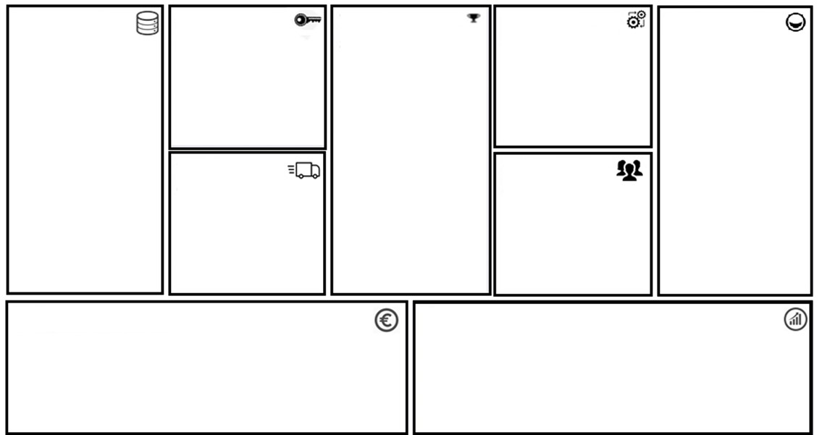
Plan - Project Canvas
More info
Data
The detailed reports about different infected volunteers of different time. Important test data of volunteers on week 4-12.
The patient tablet from Zimbabwe.
Skills
Operations on CEDAR platform
Vocabulary Creation
Communication
Value Proposition
Integration
Customers
Build Metadata template which applies FAIR principles.
Help build the infected patient model for further steps as the vaccine against schistosomiasis.
Integration of template from Cedar, and weekly health log for volunteers.
Participants and volunteers in the schistosomiasis research project.
Potential patients/hospitals in the South area.
FAIR-maturity
The metadata after applying to the template we designed could be shared with other researchers.
Output
A metadata template for NCD patient form which suits the requirement of the patients.
A proposal to LUMC for
vaccine of schistosomiasis.
Stakeholders
Meta Roestenberg
Jacqueline J.Janse
Aliya
Cost
It depends on the size of the dataset. For different types of volunteers, the costs of recording report data are different. Long term volunteers cost more on treatments and measurements.
Treatment: the infection decision, cure methods
Measurement: blood test and other health tests
Revenue
Once a vaccine against schistosomiasis is developed, revenue can be generated from the vaccine.
Other efficient treatments for schistosomiasis could also generate revenue.

Slide 10
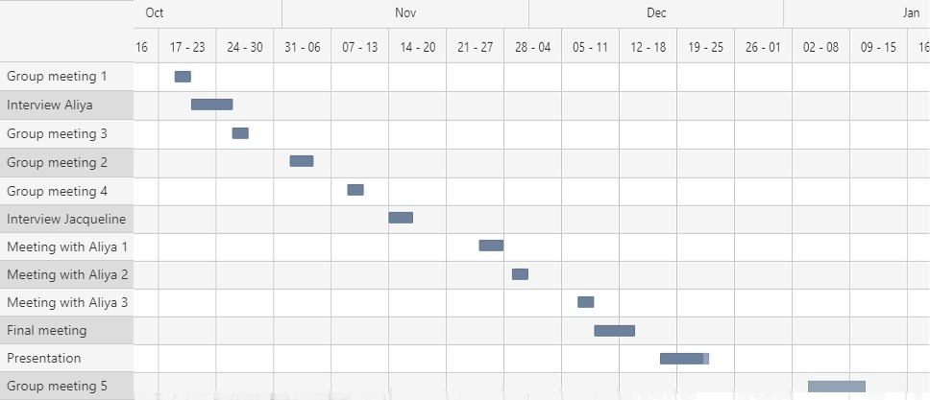
Plan - GANNT

Slide 11
Plan - Division of labour & Approch
Approach
Relevant data collection
Data analysis
Template creation
Vocabulary creation
Division of labour
Xinyue Xie
Template creation.
Yuan Lin
Communicate with stakeholder.
Host meetings.
Wei Chen
Vocabulary creation.
Yiqin Lei
- Divide the original document.
- Proofreading.
Yijie Lu
Template creation.

Slide 12
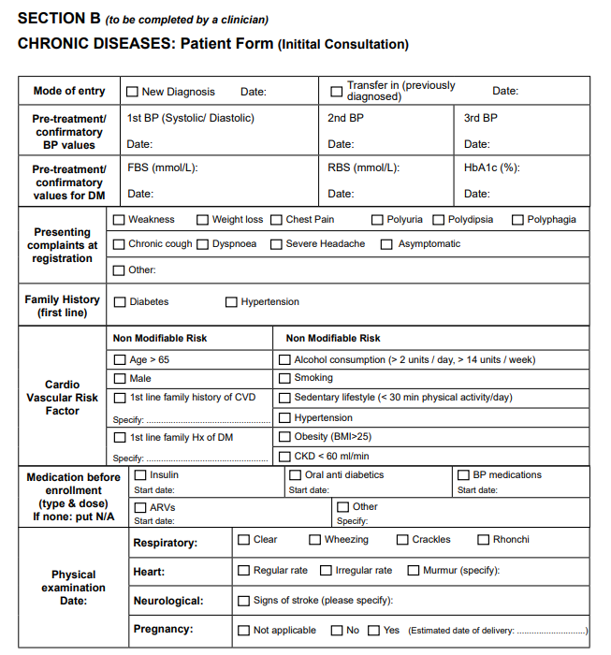
Implementation
input: NCD Patient booklet vs 1.1_201908
output: user-friendly, shareable forms for collecting metadata, with nested form form elements.
tools: CEDAR, Bioportal, SKOS Play
steps:
create metadata template
vocabulary creation
complete the metadata form(populate)

Slide 13
Implementation
create metadata template
tools: CEDAR
steps:
analyazing the form elements
designing template questions
documenting the order in which elements will appear
new template creation
adding fields for data entry
choosing and configuring the field(controlled terms, Bioportal ontologies)

Slide 14
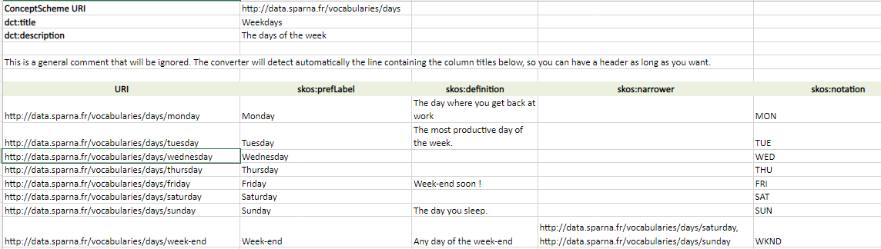
Implementation
Vocabulary creation
tools: Excel spreadsheet template, SKOS Play
approach: Excel -> RDF
steps:
Download the Excel template from Github
Edit the Excel template based on the form vocabulary
Run the SKOS Play Converter on the Excel file
Save the content as TTL file
submit resources into Bioportal
Pull up terms in CEDAR

Slide 15
Discussion
For NCD Patient booklet from Zimbabwe
Considerations based on the template we’ve obtained by CEDAR, the NCD patient booklet :
FAIR data: from hand writing data to machine readable data
Record the results from various tests for a patient
Easy to reach previous information of a patient
Possible to cooperate with other department

Slide 16
Discussion
For data from LUMC
Proposal for FAIR data:
Keep data unique and private
Machine readable from Castor to CEDAR
Better way to analysis
Possible to cooperate with other researchers for vaccine

Slide 17
Discussion
For us
What did we do, what did we gain:
Template design for NCD patient booklet from Zimbabwe:
Different data types for different patients
A beginning of FAIR data system in Zimbabwe
Proposal to LUMC about data sharing
Template based on part of experiment data for sharing
Experience with real data
(Further) Help them handle experiment data efficiently

Slide 18
Conclusion
Problem
Goal
Progress
Data collection, sharing, and integration tend to be performed in an inconsistent manner in those insufficiently developed regions
Create a metadata template based on FAIR principles and put forward a proposal for LUMC that how to do the data sharing based on the experience we have obtained from the NCD project.
NCD patient booklet project in Zimbabwe: Done
Proposal to Schistosomiasis infection (CoHSI2) project: Still under discussion.

Slide 19
Title closure

